Slide 1

DriverPass System Analysis
[Ben Dixon]
Notes:
Welcome! This presentation explains the design of the DriverPass system — a web-based platform that helps students prepare for their driving tests. I’ll cover how the system meets client needs, the main workflows, and the design decisions behind its structure and security.

Slide 2

System Requirements
Online platform for driver test preparation
Students can register, buy packages, schedule 2-hour lessons
Instructors manage availability and record lesson notes
Secretaries handle scheduling and confirmations
Admins and owners manage users, updates, and reports
Notes:
DriverPass needed an all-in-one system to handle lessons, practice tests, and progress tracking. The design supports five main roles — students, instructors, secretaries, administrators, and the owner — each with secure access to only what they need. This structure prevents overlap, reduces scheduling errors, and makes the business more efficient.

Slide 3
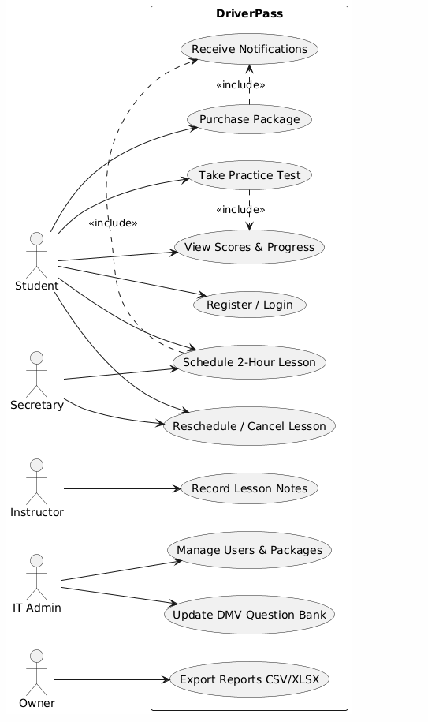
Use Case Diagram
Notes:
This diagram shows the primary system interactions. Students and secretaries can schedule or modify lessons, instructors record lesson notes, and admins manage users and DMV question banks. Notifications are automatically sent for bookings and updates. Each actor interacts only with the functions necessary for their role, keeping the system simple and secure.

Slide 4
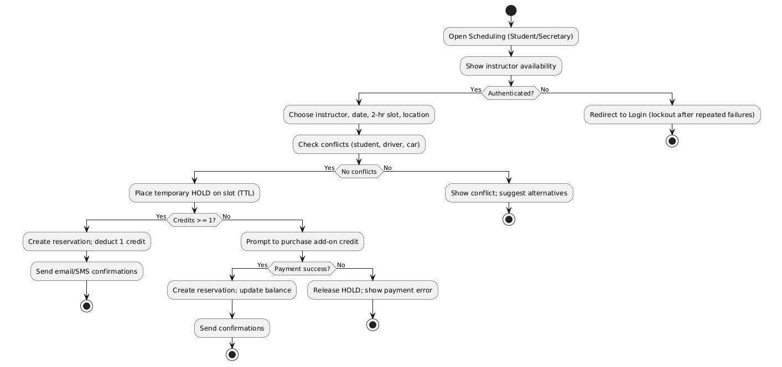
Activity Diagram
Notes:
This flow models how a student or secretary schedules a lesson. It checks for instructor and vehicle conflicts, verifies that the student has credits, and places a temporary hold to prevent double-booking. If payment or credits are available, the system confirms the reservation and sends an email or text confirmation. This automation ensures accuracy and saves administrative time.

Slide 5
Security
HTTPS encryption and secure logins
Account lockout after failed attempts
Role-based access control (RBAC)
Password hashing (bcrypt / Argon2)
Audit logs and data backups
Stripe payment integration (PCI compliant)
Notes:
Security was a major client concern. The system uses strong encryption and password protection, account lockouts for repeated failures, and strict RBAC to prevent unauthorized access. Payment data is processed securely through Stripe, which ensures PCI compliance. Daily backups and logs help maintain reliability and accountability.

Slide 6
System Limitations
Web application only (no mobile app yet)
Payments limited to credit/debit cards
English language and US time zones only
DMV test scheduling not integrated
Notes:
For this release, the system focuses on core functionality — web scheduling and online test prep. Mobile apps, internationalization, and DMV test integration are planned for later phases. These limitations keep the first release achievable within scope and budget.

